Slide 1

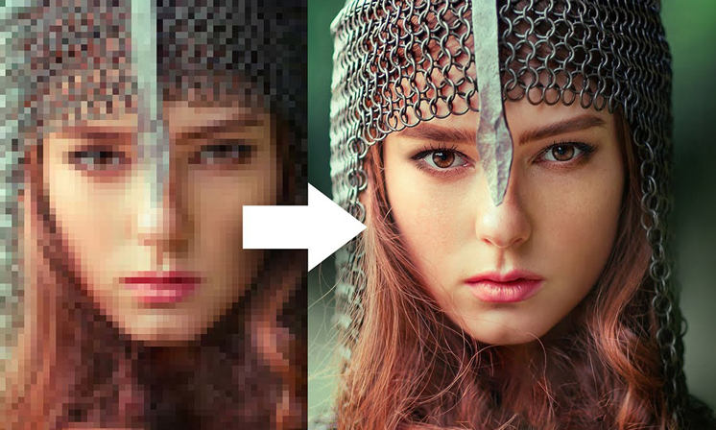
Image Enhancement with Super-Resolution and Controlled Noise
24-1-R-12
Students: Liza Shvachka
Avishai Hershkovitz
Supervisor: Dr. Renata Avros

Slide 2
Introduction the problem
Existing models rely on clean images for restoration, which are sometimes unavailable.
Traditional models require deep understanding.
Dealing with the real world where images are varied, including different exposure levels

Slide 3
Introduction - Importance of Image Restoration
Image is a visual representation capturing scenes, and objects, essential for conveying ideas and experiences.
Enhance clarity, detail, and overall quality.
Improve visual understanding and interpretation.
Correct imperfections for better usability.

Slide 4
Introduction the problem
Existing models rely on clean images for restoration, which are sometimes unavailable.
Traditional models require deep understanding.
Dealing with the real world where images are varied, including different exposure levels.

Slide 5
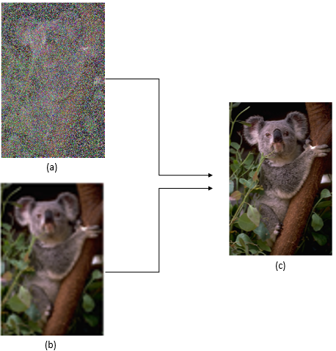
Suggested Solution
Utilize Deep learning model Noise2Noise employing U-net.
Implement Super Resolution Deep learning model using RU-net.
Restoring images based only on corrupted images.
Analyze corruption nature for efficient image restoration.

Slide 6
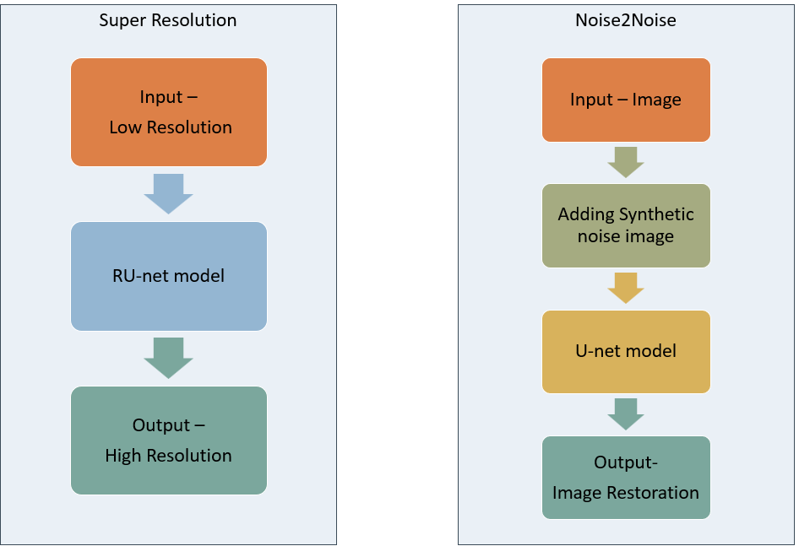
Flow Chart

Slide 7
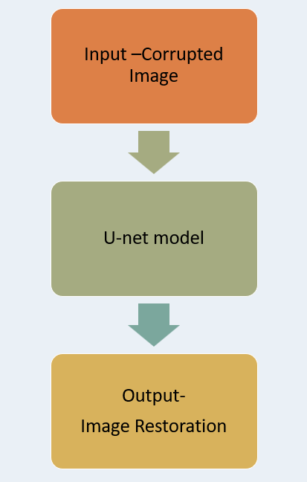

Noise2Noise

Slide 8
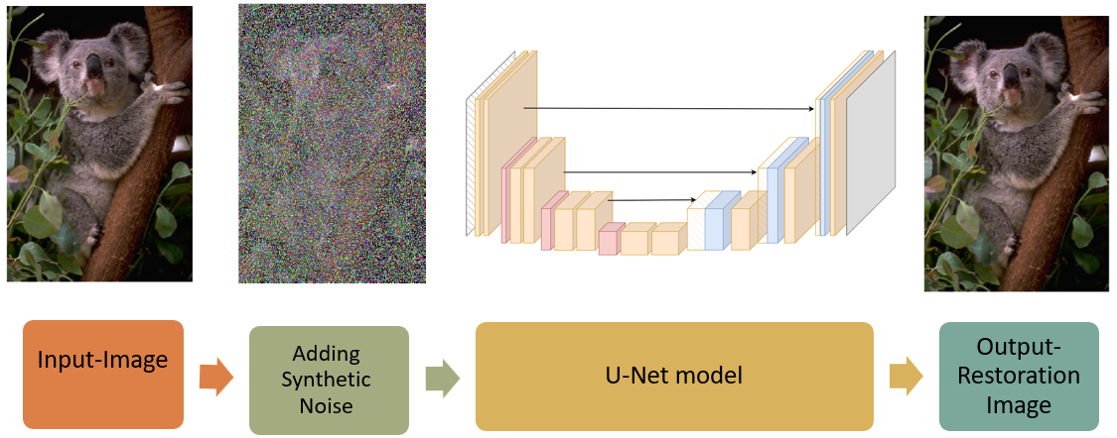
Noise2Noise Train Process
Input: Image from various sources for training.
Adding Synthetic Noise: Simulating real-world conditions.
U-net Model Training: Iteratively mapping noisy to clean images.
Output: Image Restoration with reduced noise.

Slide 9
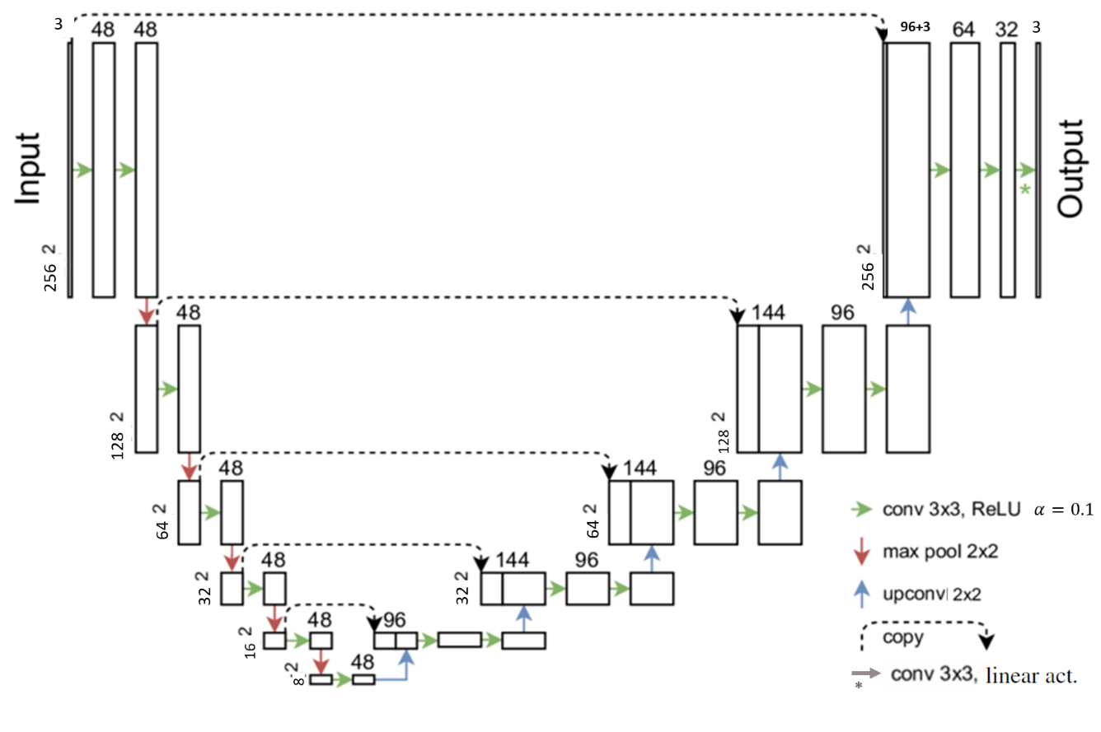
Noise2Noise - U-net Phase

Slide 10
Super Resolution

Slide 11
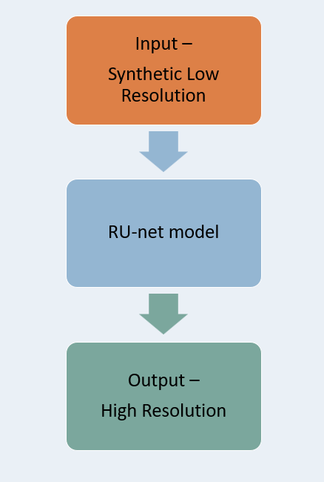
Super Resolution Train process
Synthetic Low-Resolution input: High-resolution images, down-sampled, blurred, up-sampled.
RU-net Model: Degradation module and a new U-net architecture
Output: High-resolution, denoised, visually enhanced images.

Slide 12
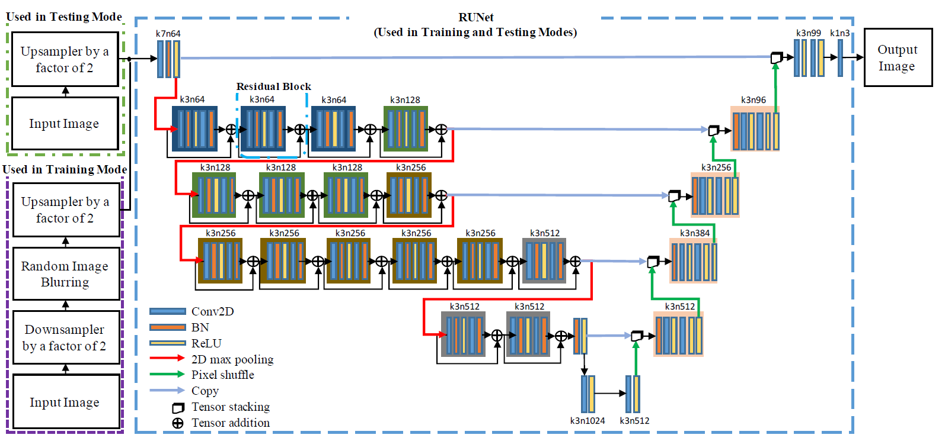
Super-Resolution - RU-net Phase

Slide 13
Expected Achievements
Enhance super-resolution techniques without explicit images.
Transforming corrupted images into clean .
Compare effectiveness of our models of reconstructions.
Integrating both models into a unified model is planned.

Slide 14
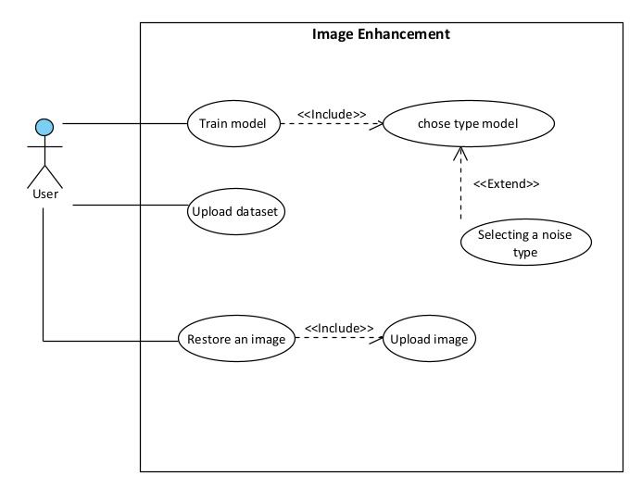
Use Case

Slide 15
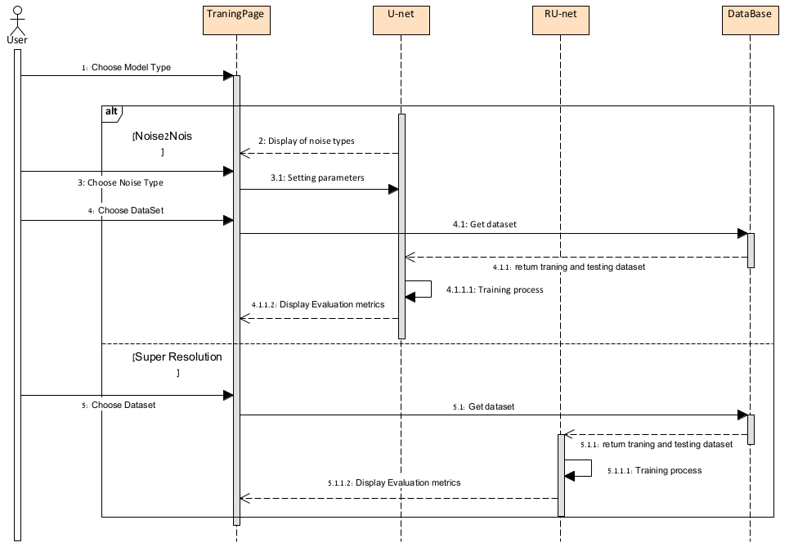
Sequence

Slide 16

GUI
Home page

Slide 17
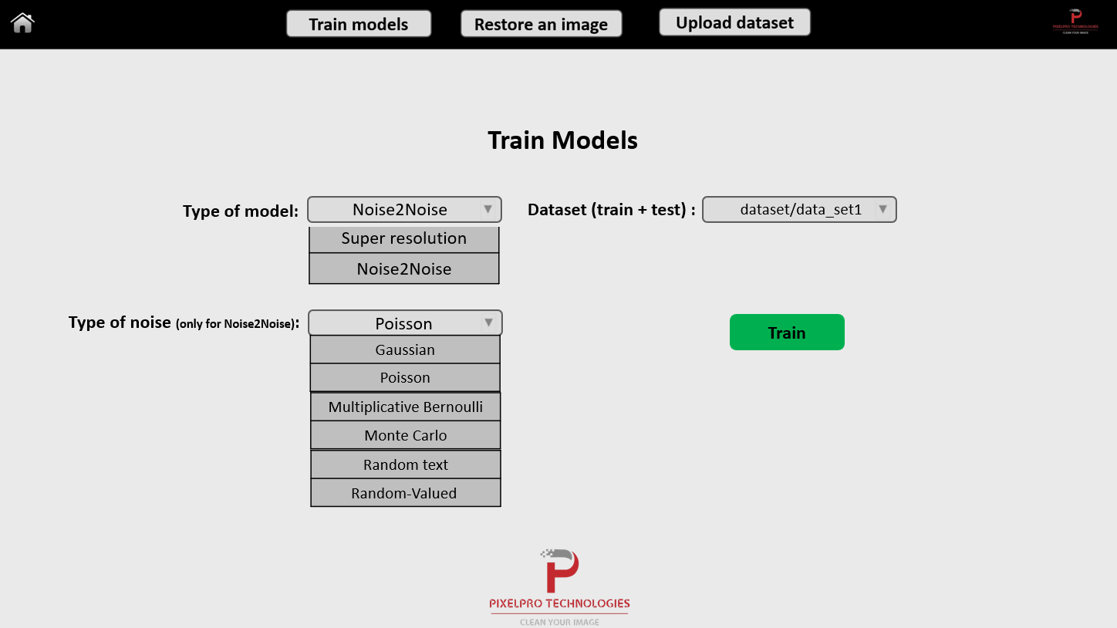
GUI
Train Models page

Slide 18
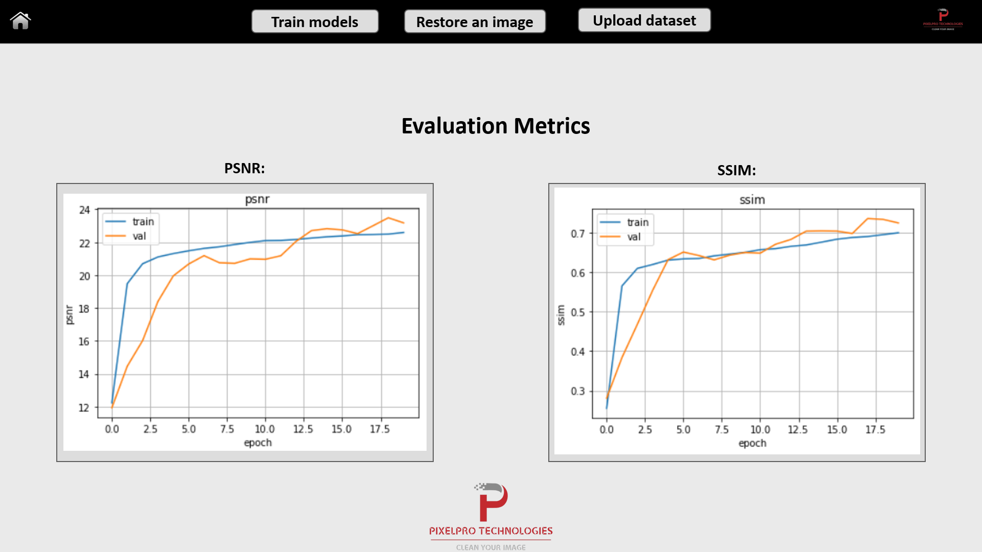
GUI
Evolution metrics of train page

Slide 19
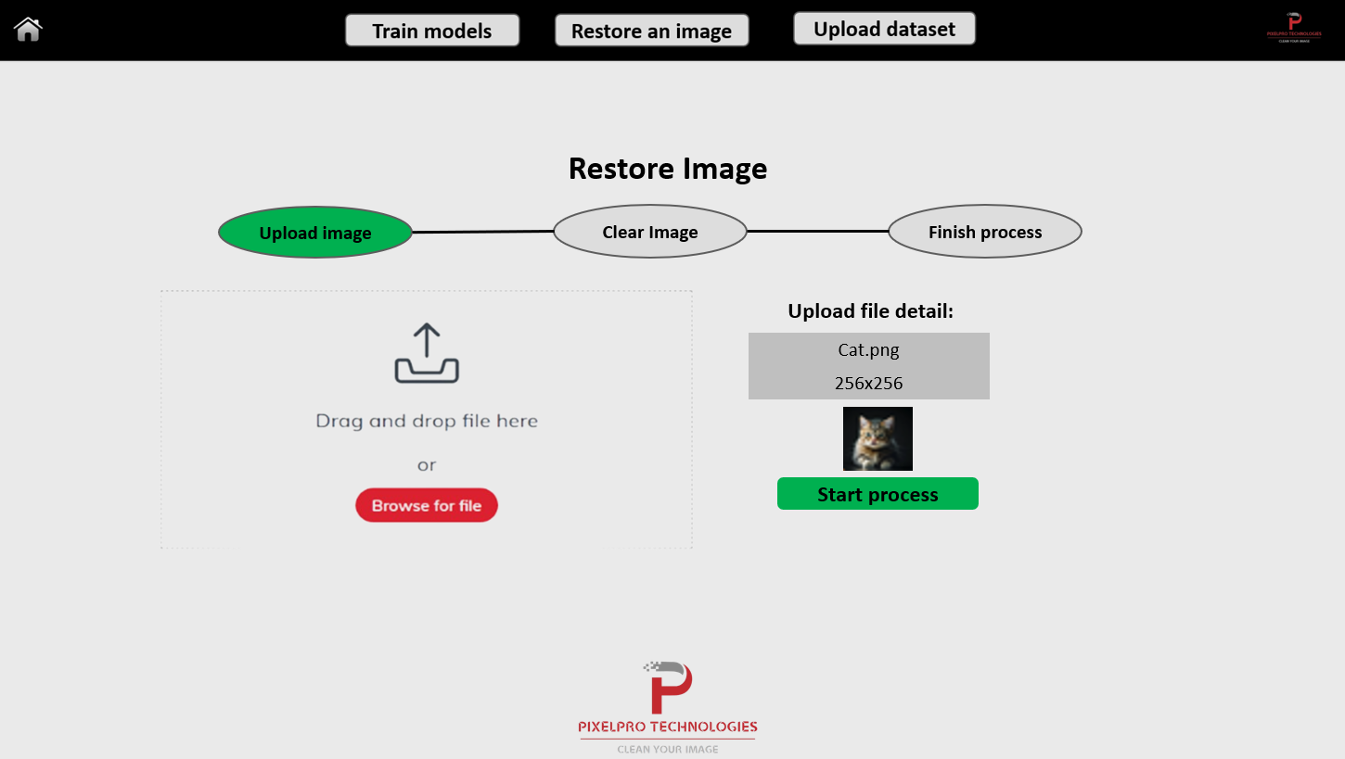
GUI
Restore Image page

Slide 20
Main Test process
Excepted result | Test description | Module
Open 'Home’ page | Click 'Home' button in navbar menu | Home page
Open 'Train Models’ page | Click 'Train Models' in navbar menu | Home page
Open 'Restore an image’ page | Click 'Restore an image' button in navbar menu | Home page
Open 'Upload dataset’ page | Click 'Upload dataset' button in navbar menu | Home page
Option ‘Super resolution' should be chosen. | Click on combo box 'Type of model' and choose 'Super resolution' | Train Models window>Type of Model
Option ‘Noise2Noise' should be chosen | Click on combo box 'Type of model' and choose 'Noise2Noise' | Train Models window ->Type of model
Option ‘Gaussian' should be chosen | Click on combo box 'Type of noise' and choose 'Gaussian' | Train Models window ->Type of model (Noise2Noise)->Type of noise
Open 'Train process' window with active training timer and current PSNR present window. | Click on 'Train' button | Train Models window ->Train Process window
Advance to step of Clear image processing with active precent of the clear | Click on button 'Start process' | Restore an image window->Clear image
Download the clean image to your computer | Click on button 'download' | Restore an image window->Finish process
a alert in green will pop up with message 'Dataset uploaded' | Click on 'Import dataset' button | Upload dataset window

Slide 21

Thanks for your attention!
Liza Shvachka
Avishai Hershkovitz

